Slide 1
The Battle of Neighborhoods A Capstone Project for IBM Applied Data Science Capstone Course
By: Zachary Switaj

Slide 2
Introduction/Business Problem
FooBar Cycles would like to add a new premium indoor cycling studio on the New Hampshire Seacoast area
Senior management is looking for a town with relatively high earners who are willing to support fitness venues

Slide 3
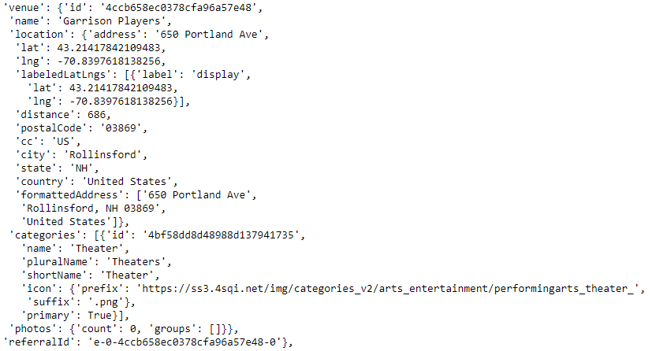
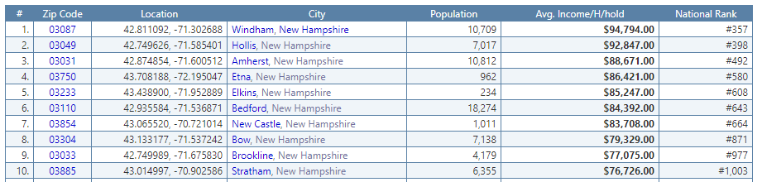
Data
Foursquare API
Used to identify venues (businesses, points
of interest, etc.) in each of the indicated towns
Zip-codes.com
Finding all towns within specified radius of Rollinsford, NH – as specified by senior management
Zipatlas.com
Extract location, population, and
Income data for towns in NH and ME

Slide 4




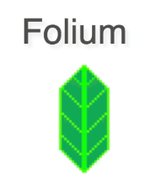




Methodology (Tools Used)
Python Jupyter Notebook
Code storage and analysis
BeaufitulSoup
Web scraping of location and socioeconomic data
Pandas, numpy
Data analysis
Folium, geopy, matplotlib
Data visualization
Scikit-learn
Data preprocessing and classification
Foursquare API
Obtain venue data

Slide 5
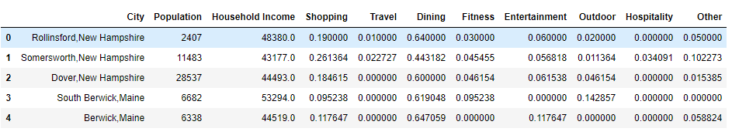
Methodology
Socioeconomic and location data was scraped using BeautifulSoup from zip-codes.com and zipatlas.com
Folium was used to visualize potential towns of new location
The Foursquare API identified venues within each town and venues were assigned into groups of categories for further analysis
Data was encoded using the one-hot method to summarize venue categories presence in a given town

Slide 6
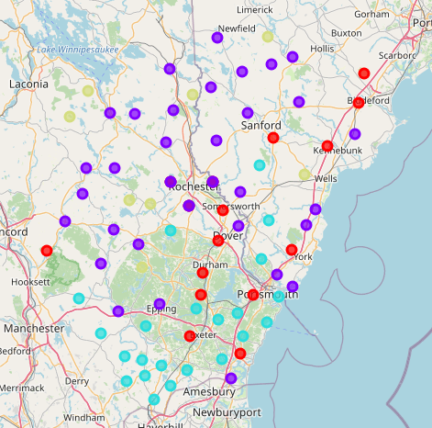
Results
Data was preprocessed using a MinMaxScaler
K-means clustering (k=4) run on numerical features to separate towns into 4 distinct segments
Clusters were plotted by color for further visual
analysis

Slide 7
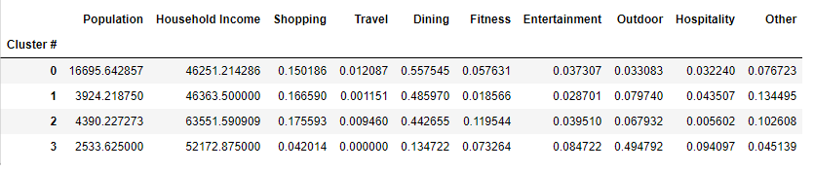
Results (con’t)
Results were summed by cluster to identify following characteristics:
Cluster #0: High population, medium income, high density of dining venues, low density of outdoor venues
Cluster #1: Medium population and income, low density of fitness venues
Cluster #2: Medium population, high income, high density of shopping and fitness venues, low density of hospitality venues
Cluster #3: Low population, medium-high income, low density of shopping and dining venues, very high density of outdoor venues

Slide 8
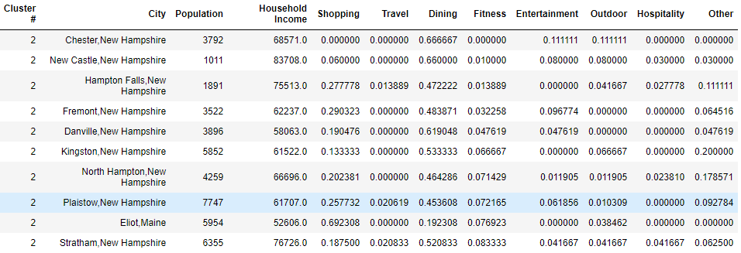
Discussion
Cluster 2 was chosen as the best cluster for a new location due to:
Moderate population
High income
High density of fitness venues
Towns within this cluster with a low fitness venue were identified to reduce competition

Slide 9
Discussion (con’t)
A group of towns in cluster #2 with high income and low fitness venue density were identified.
The towns of Danville and Fremont, NH were
identified as leading towns for the new location

Slide 10
Conclusion
Further analysis to be done regarding town ordinances and taxes related to new businesses
Additional demographic data could be added as features for the classification algorithm
Data from other successful FooBar Cycles locations could be used to identify similar towns in the target area

